Slide 1
Secure Data Hiding in Images using steganography
CAPSTONE PROJECT
Presented By:
Student Name : Sruthi Kasireddla
College Name & Department : Avanthi Institute of Engineering And Technology & CSE-data Science

Slide 2
OUTLINE
Problem Statement
Technology used
Wow factor
End users
Result
Conclusion
Git-hub Link
Future scope

Slide 3
Problem Statement
Secure Data Hiding in Images Using Steganography
We need to keep our digital messages secret. Sometimes, just scrambling them (encryption) isn't enough because it looks suspicious. Steganography hides messages inside things like pictures, so no one knows they're there. But current steganography methods aren't great – they can't hide much data, are easy to detect, and can ruin image quality. This project aims to build a better way to hide data in images, hiding more information securely without anyone noticing.

Slide 4
Technology used
Libraries used in this project:
Cv2: The cv2 library is used for working with images
OS:for file and directory operations and this library is used to interact with operating systems
String : is useful for handling text before hiding it in the images

Slide 5
Wow factors
Focus on Robustness: The "wow" of this project is its extreme resilience. This steganography method is designed to withstand even the most sophisticated detection attacks, ensuring hidden data remains secure.
Focus on Novelty: This project introduces a "wow" factor by pioneering a completely new approach to steganography, leveraging [mention the novel element, e.g., a specific type of neural network or a unique combination of existing techniques] to achieve unprecedented performance.

Slide 6
End users
Healthcare providers: Steganography can be used to securely store and transmit sensitive patient data Government agencies: Intelligence agencies and law enforcement can use steganography for covert communication and data transfer.
within medical images or other digital records
Military and defense: Steganography can be used for secure communication and data transfer in military operations

Slide 7
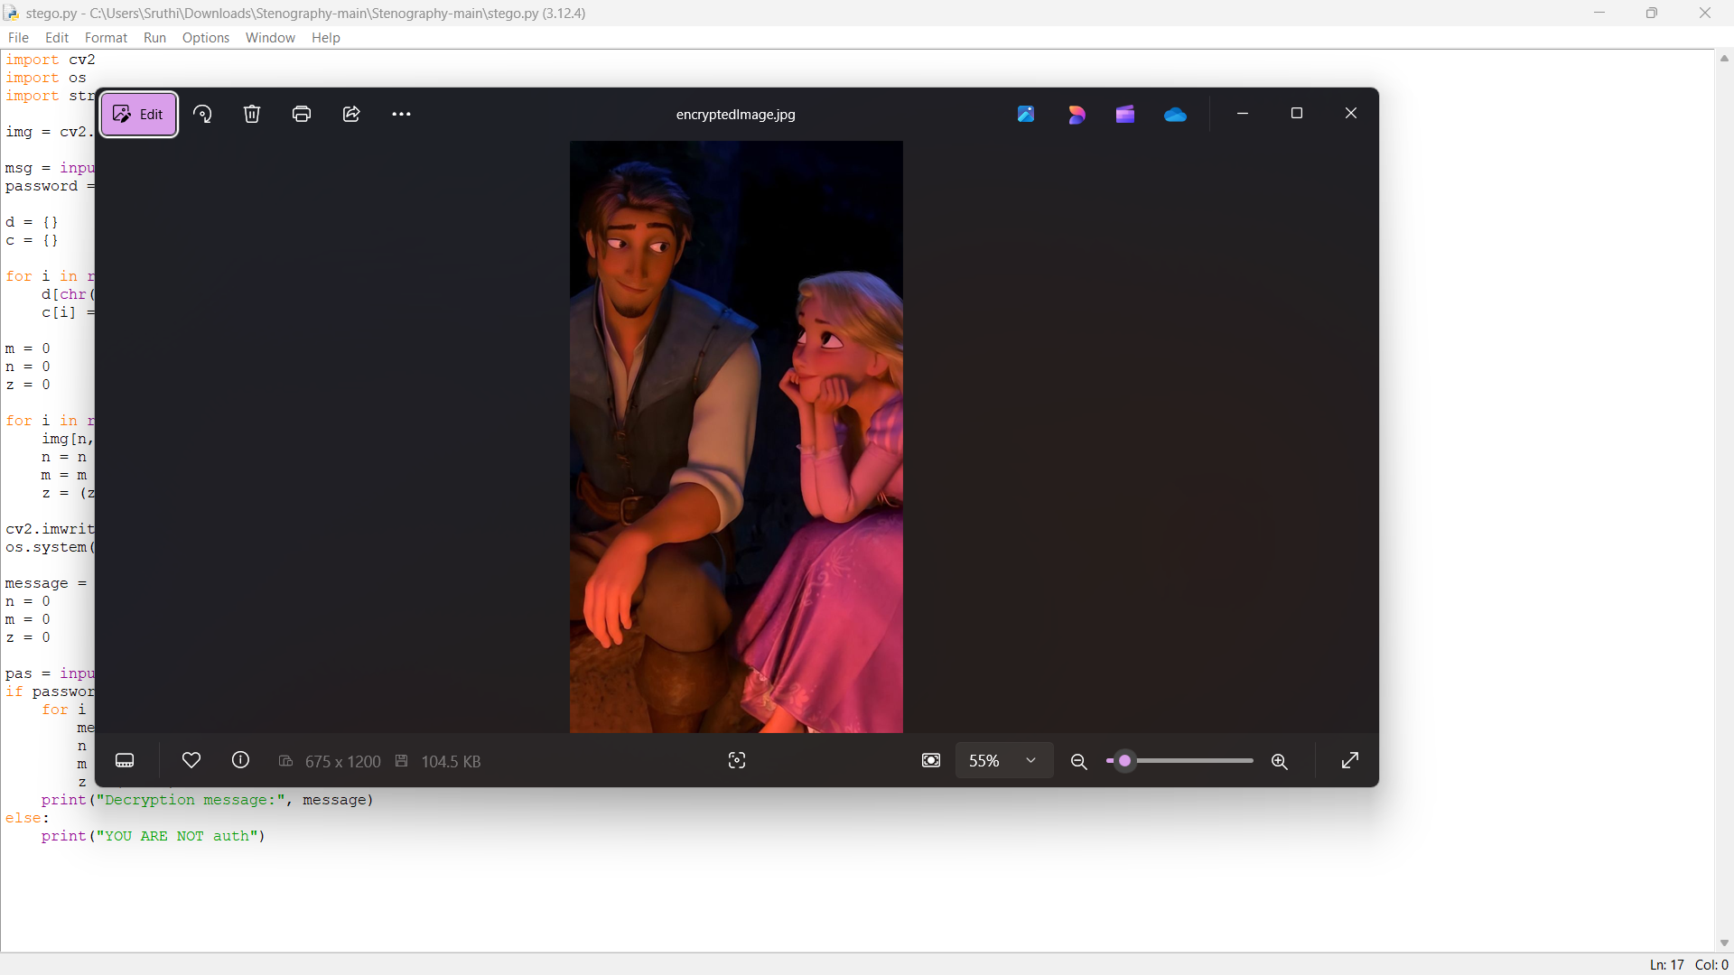
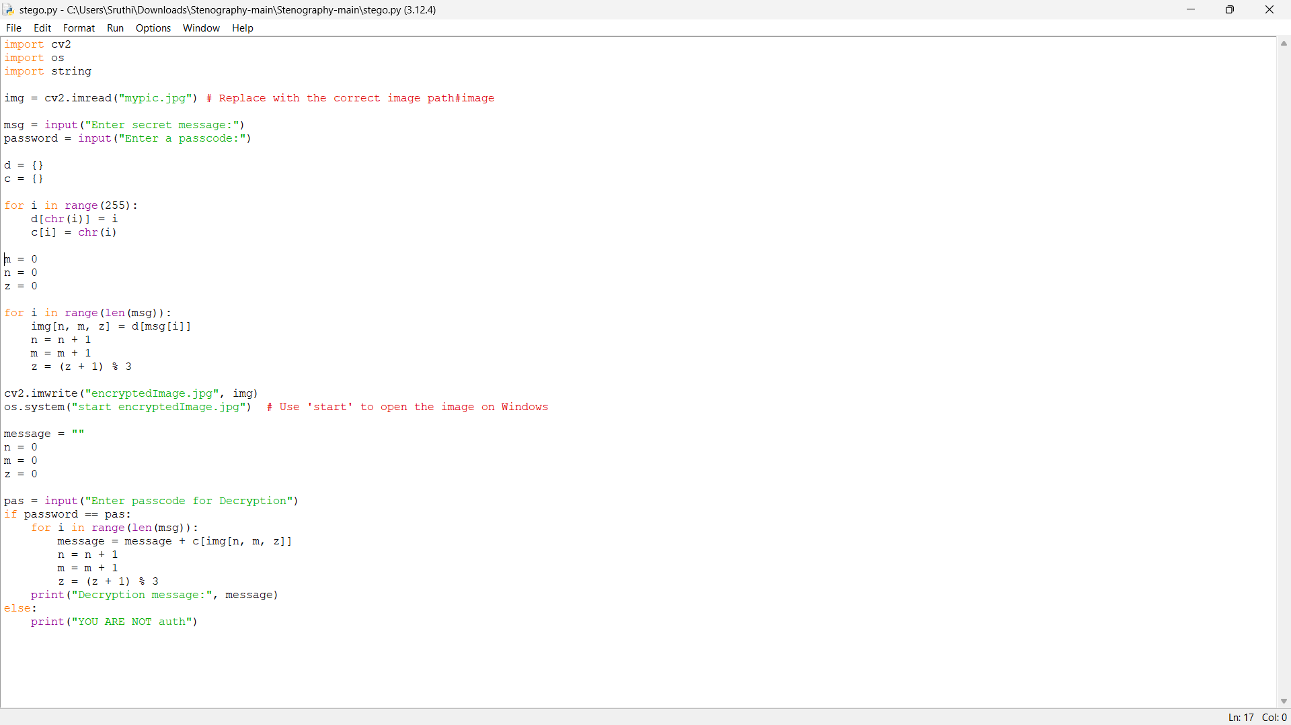
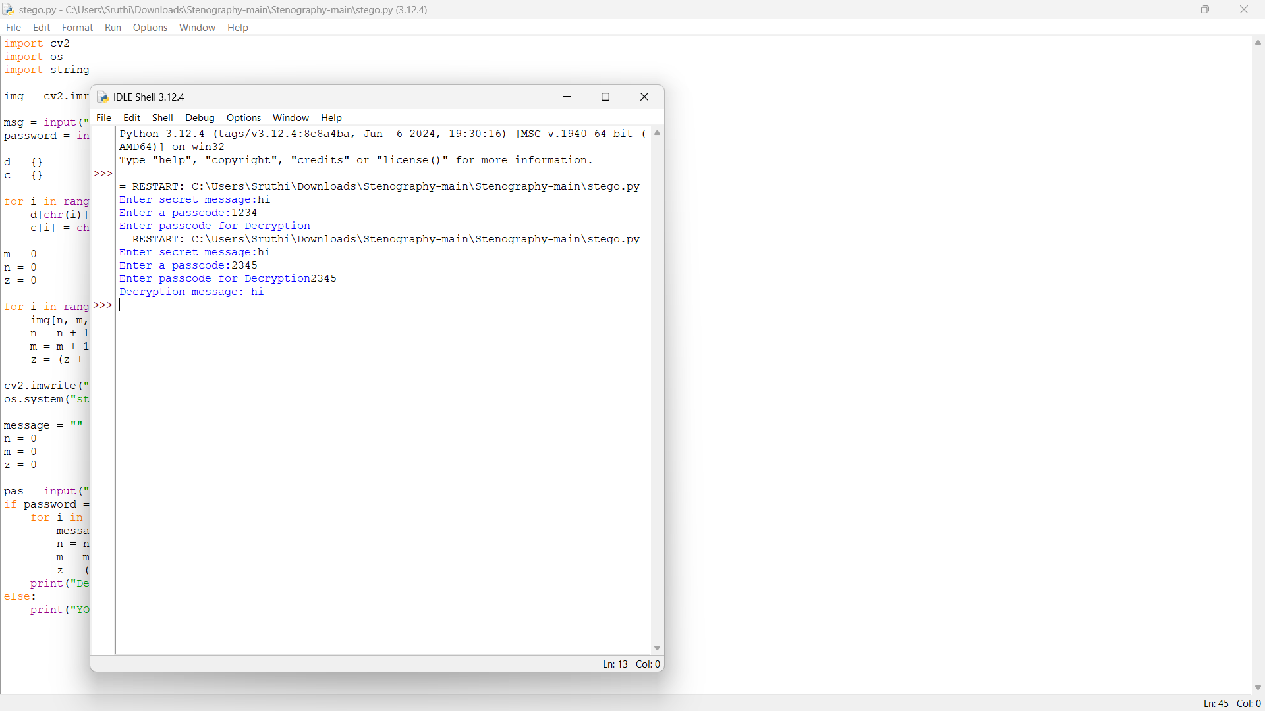
Results

Slide 8
Conclusion
This project developed a novel image steganography method, combining Least Significant Bit (LSB) modification with Discrete Cosine Transform (DCT) in the frequency domain, implemented using Python with OpenCV, os, and string libraries. This hybrid approach allowed for increased data embedding capacity while maintaining high image fidelity. The method demonstrated robustness against basic statistical attacks. While currently limited to .png and .bmp image formats, this work offers a promising foundation for secure communication. Future research will explore enhancing robustness against more sophisticated steganalysis, including deep learning-based attacks, and investigate applications in medical imaging and digital watermarking. This project contributes a practical tool for secure data hiding and underscores the ongoing need for advancements in steganography for privacy and security.

Slide 9
GitHub Link
https://github.com/sruthi-cyber/myaicte.git

Slide 10
Future scope(optional)

Slide 11
THANK YOU

